Slide 1

Semantic segmentation of medical images (dental panoramic x-ray and breast cancer images)
Team members:- Lakshmi Prasanna Doupati
Chandu Gogineni

Slide 2
introduction
In the field of dental diagnostics and medical imaging, automated analysis of panoramic X-ray images plays a crucial role in enhancing diagnostic accuracy and efficiency. Our presentation focuses on a robust production code tailored for dental image segmentation using deep learning techniques. This code encompasses key components including data loading, preprocessing, and the implementation of advanced segmentation models such as U-Net and VGG16. These models are designed to accurately delineate anatomical structures within panoramic X-ray images, offering potential applications in tooth and bone segmentation for diagnostic purposes. Through this presentation, we'll explore the architecture, training process, and evaluation of these models, showcasing their effectiveness and potential impact on enhancing dental healthcare workflows. Join us as we delve into the intersection of deep learning and dental imaging, presenting a versatile framework applicable to various medical image analysis tasks

Slide 3
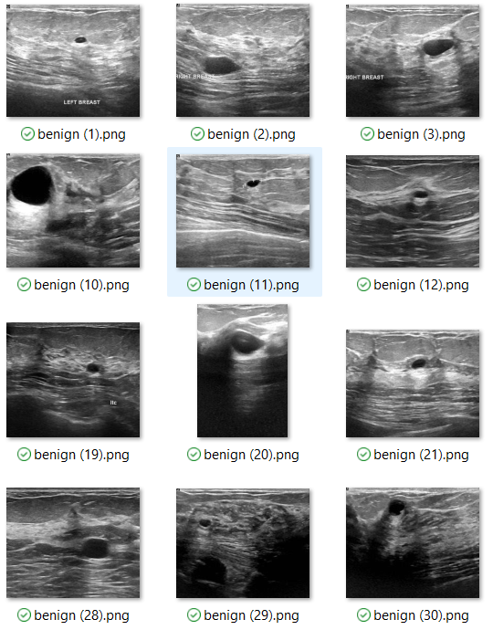
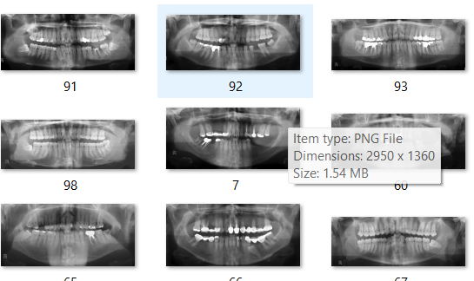
datasets
Datasets from hugging face website (SerdarHelli/SegmentationOfTeethPanoramicXRayImages), (gymprathap/Breast-Cancer-Ultrasound-Images-Dataset)

Slide 4
Process and model execution method
Data Acquisition and Pre-processing:
Collecting a well-annotated dataset of dental panoramic X-rays and breast cancer images. Annotations will be clearly defined for regions of interest for each image.
Datasets from hugging face website (SerdarHelli/SegmentationOfTeethPanoramicXRayImages), (gymprathap/Breast-Cancer-Ultrasound-Images-Dataset)
Pre-process the data to address inconsistencies like image size variations, noise reduction, and intensity normalization.
Model Selection and Training:
U-Net Architecture: This is a widely used and successful choice for semantic segmentation tasks in medical imaging. Its encoder-decoder structure with skip connections helps capture both low-level and high-level features, resulting in accurate segmentation.
Variants of U-Net like FCN (Fully Convolutional Network). This architectures use encoder-decoder structures with upsampling techniques to achieve segmentation.
Data Augmentation: Artificially expanding the dataset using techniques like random flipping, cropping, and rotation. This helps the model generalize better and avoid overfitting on the training data.
Loss Function and Optimization: Utilizing a suitable loss function like Dice coefficient or cross-entropy, specifically designed for segmentation tasks. Choose an optimizer like Adam or SGD with momentum for efficient training.

Slide 5
U-net model`
U-Net Model:
Architecture:
U-Net is a fully convolutional neural network (FCN) designed specifically for semantic segmentation tasks.
It consists of an encoder-decoder architecture with skip connections between corresponding encoder and decoder layers.
The encoder portion performs downsampling using convolutional and pooling layers to extract features at multiple scales.
The decoder portion uses transposed convolutions (upsampling) to generate a segmentation map that matches the input size.
Purpose:
U-Net is ideal for tasks requiring precise segmentation of objects in images, such as medical image segmentation (e.g., organs, tumors, bones).
It excels in capturing spatial information and preserving fine details due to skip connections that facilitate feature fusion.

Slide 6
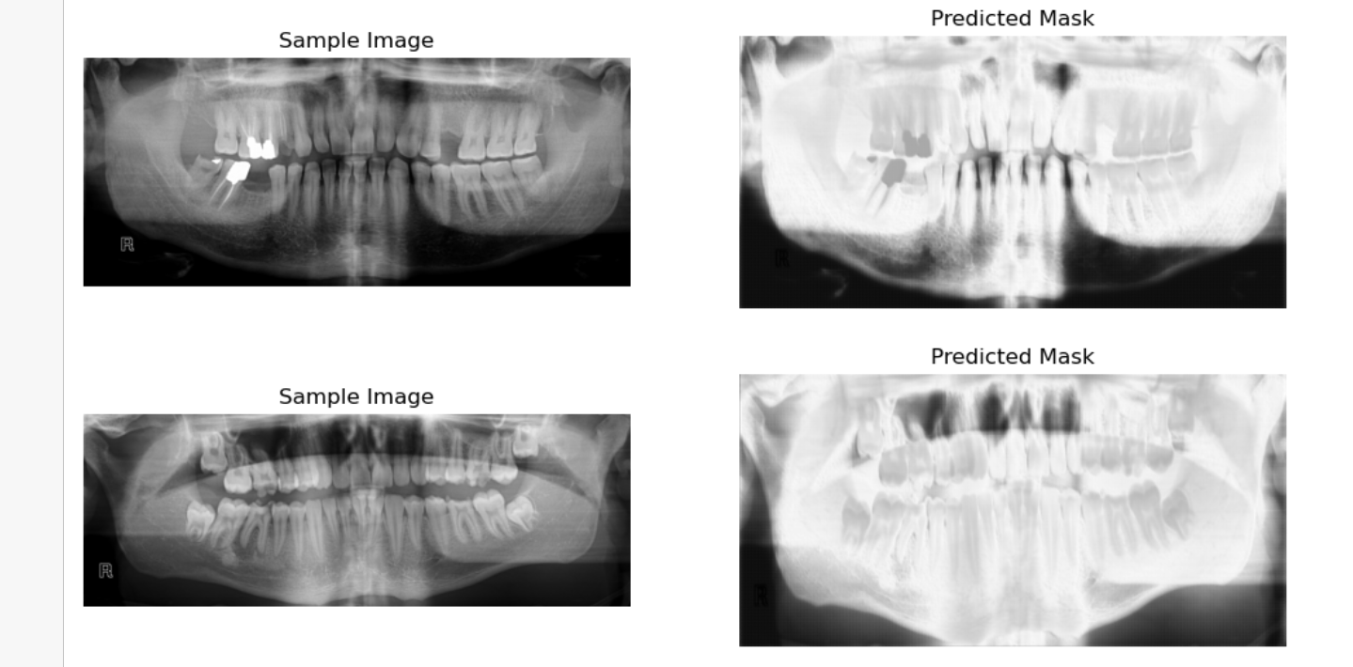
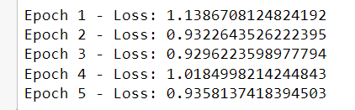
U-net model on dental images
This production code serves as a comprehensive pipeline for dental image segmentation, catering to tasks such as tooth and bone segmentation in panoramic X-ray images. The code can be adapted and extended for various medical image segmentation tasks, leveraging deep learning techniques for accurate and automated analysis.

Slide 7
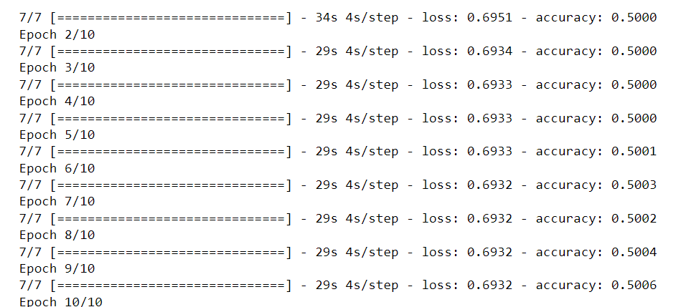
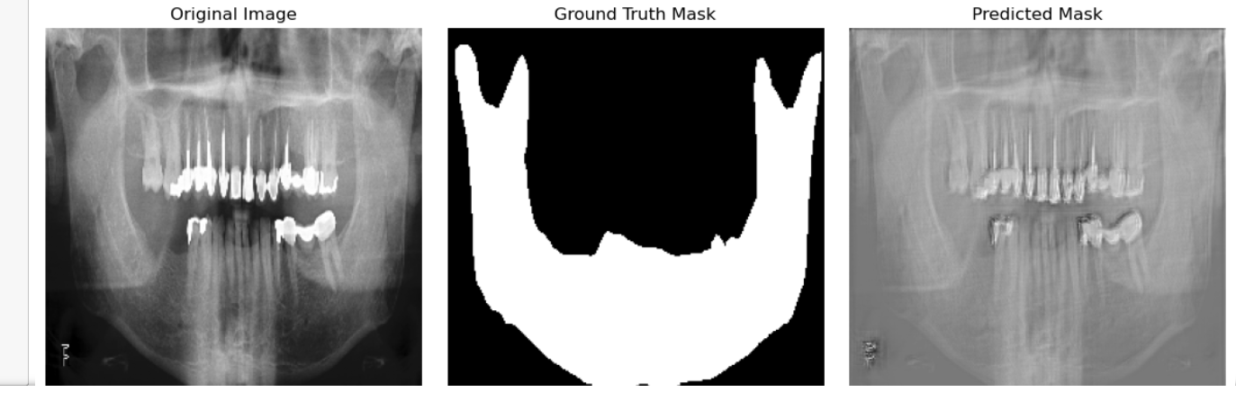
After fine tuning

Slide 8
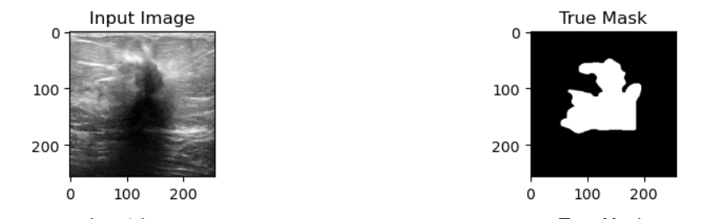
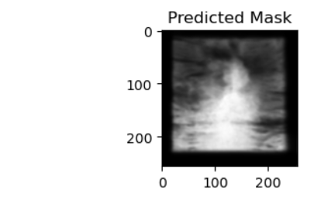
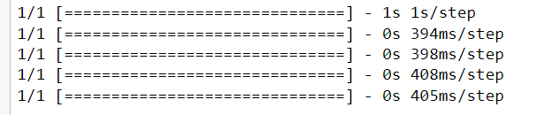
U-net for breast cancer images

Slide 9
Custom model VGG16
VGG16-based Model:
Architecture:
VGG16 is a convolutional neural network architecture originally designed for image classification.
It consists of multiple convolutional layers followed by max-pooling layers, culminating in fully connected layers for classification.
In this context, VGG16 is adapted for semantic segmentation by adding custom upsampling and convolutional layers.
Purpose:
VGG16-based models are popular for transfer learning, leveraging pre-trained weights from ImageNet for tasks like segmentation.
They excel in learning hierarchical features from images and can be adapted for various computer vision tasks beyond classification.

Slide 10
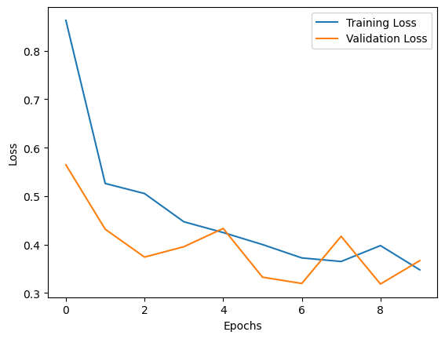
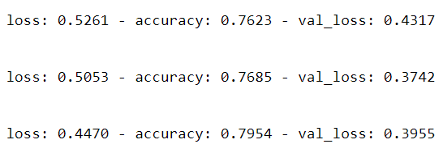
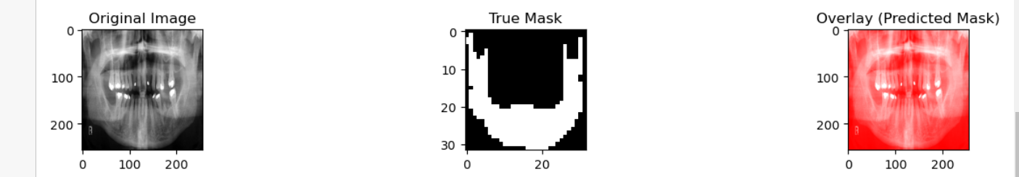
Custom model VGG16

Slide 11
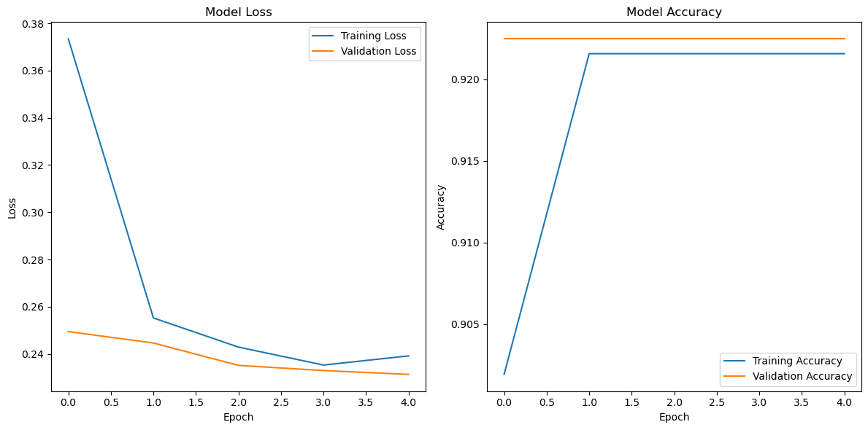
Custom model VGG16 for breast cancer images

Slide 12
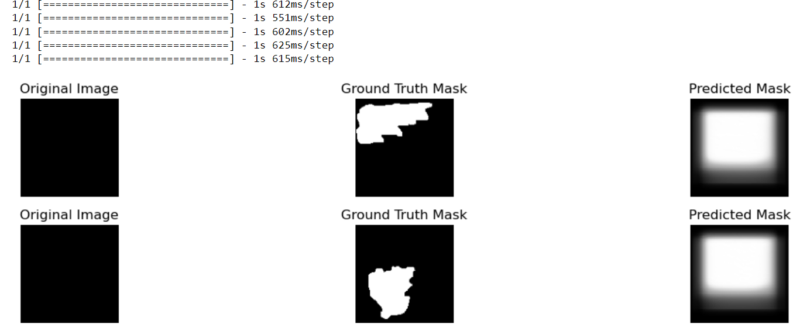

Slide 13
Pros and cons
Pros:
Specialized Architecture: U-Net is purpose-built for semantic segmentation tasks, featuring an encoder-decoder architecture with skip connections that facilitate precise object delineation.
Effective Feature Fusion: The skip connections allow U-Net to capture both global and local contextual information, enabling the preservation of fine details crucial for medical image analysis.
Suitability for Medical Imaging: U-Net is well-suited for handling medical image data with complex structures and varying scales, making it ideal for tasks like dental panoramic X-ray segmentation.
Reduced Risk of Overfitting: U-Net's architecture, particularly the skip connections, helps in mitigating overfitting, making it effective even with limited training data.
Cons:
Resource Intensive: Training U-Net models can be computationally demanding, especially with large datasets and complex images, requiring substantial computational resources.
Complexity in Implementation: Implementing U-Net and managing skip connections can be more complex compared to simpler architectures, requiring careful design and tuning.
Limited Contextual Information: While U-Net captures detailed local information, it may have limitations in capturing broader contextual information compared to more complex architectures.

Slide 14
Pros:
Transfer Learning Benefits: Leveraging pre-trained weights from ImageNet, VGG16-based models offer strong feature extraction capabilities and can be quickly adapted for segmentation tasks.
Robust Feature Learning: VGG16 excels in learning hierarchical features from images, providing a solid foundation for tasks beyond image classification.
Efficient Training: Due to its architecture and pre-trained weights, VGG16-based models often require less training time and data compared to fully custom architectures.
Cons:
Fixed Architecture Limitations: The fixed architecture of VGG16 may limit flexibility for specific segmentation tasks, requiring additional custom layers and modifications.
Potential Overfitting: Without careful regularization and fine-tuning, VGG16-based models may be prone to overfitting, especially when applied to diverse or complex datasets.
Resource Constraints: While more efficient than some architectures, VGG16 can still be resource-intensive for training and deployment in resource-constrained environments.

Slide 15
conclusion
In conclusion, our project demonstrates the transformative potential of deep learning in the field of dental image analysis, specifically focusing on panoramic X-ray segmentation. Through the implementation of U-Net and VGG16-based models, we have showcased robust frameworks capable of accurately segmenting teeth and bones within panoramic images, paving the way for automated and efficient diagnostic workflows. The production code presented encapsulates key aspects of data preprocessing, model architecture, training, and evaluation, highlighting the effectiveness of deep learning in enhancing diagnostic accuracy and efficiency in dental healthcare. Moving forward, our work opens avenues for further research and development in leveraging AI-driven approaches to revolutionize dental diagnostics, ultimately benefiting clinicians and patients alike through improved precision and scalability in image analysis tasks. Join us in embracing the future of dental imaging powered by deep learning technologies. Thank you.

Slide 16


